Slide 1

ICEG
REVIEW COMITE
03/05/2023

Slide 2
AGENDA
Status Data Standardisation/
ICEG I’m Moving
ICEG Hydrants
ICEG Building
OSLO Standard adoption process
OTHER

Slide 3
ICEG I’m Moving

Slide 4
Objective
Make the data and procedures accessible and executable to simplify collaboration and integration of the various services and tools. In addition, we want to make the data and procedures easily reusable across different governmental levels and public and private partners.

Slide 5
Method
SotA review
Organization and (Public) Service Standards
Business Rule Modeling Standards
Stakeholder interviews
Use Cases and Requirements analysis
Model design
Iterative feedback to further detail the UCR and improve the model

Slide 6
State of the Art Standards
Public Organization: CPOV (+OSLO AP, +BELGIF AP)
Public Service: CPSV AP (+OSLO AP/IM, +BELGIF AP)
IPDC/LPDC, Algoritmeregister
Procedure: User Journey, BPMN
Automatisch advies, Open Proceshuis
Case: Dossier (OSLO AP)
Evidence: CCCEV (+OSLO AP)
OOTS
Notes:
AP = Application Profile IM = Implementation Model

Slide 7
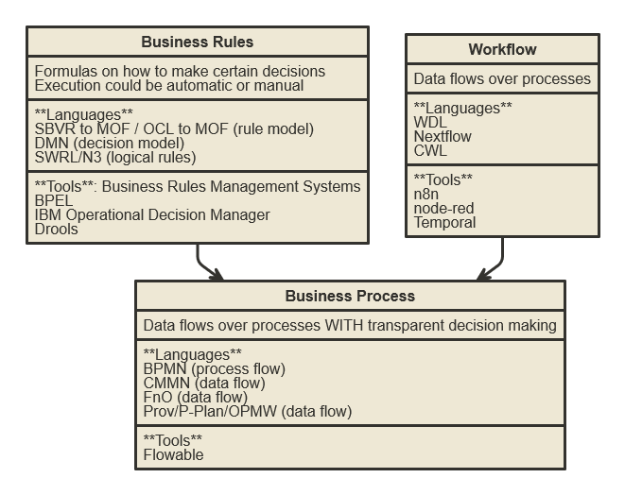
State of the Art - Business Rules

Slide 8
Interviews
Interviewees:
Raf Buyle (ADV)
Liesbeth D’hondt (BOSA)
Marc Bruyland (BOSA)
Veronique Volders (ABB)
Pieter Vanhoutteghem (BOSA)
Stefanie Kerckhof (ADV / ABB)

Slide 9
Main findings
Interoperability initiatives are currently mainly focused on exchanging data, not on procedures.
There is a growing demand for a standardized approach to describing procedures, e.g. for SDG, IPDC/LPDC.
There is currently no LOD standard that supports the description of procedures. At present, procedures are often documented in unstructured text or represented using Business Process Model and Notation (BPMN).
There is a willingness to actively support this standardisation process.
There is the hope that a semantic standard to describe procedures will bring us a step closer to the automation of many G2C processes.

Slide 10
Use Cases and Requirements
R-S1: Semantic ontology
UC-S1: Decentralised: different policy levels (municipal, regional, federal) should be able to manage their own procedures independently
UC-S2: Standardized (Linked Data) machine-readable format: procedures should be automatically ingested by machines
R-D1: Division between listing rules and deploying executable procedures
UC-D1: The latest version should be under governance of the authentic source, aligned with regulation where relevant.
UC-D2: Different organizations should be able to deploy different procedure “flavors”
R-C1: Case management
UC-C1: Following up and managing specific cases (i.e., keeping track of a person's current status in the context of a specific procedure) should be linked to the procedures that are executed.
R-T1: Subprocedures
UC-T1: High-level procedure descriptions should allow to align and harmonize different procedure flavors across organizations
UC-T2: Low-level procedure descriptions should be optimizable.
R-U1: A procedure is a sequence of steps
UC-U1: A link with prevalent visual notations such as BPMN and User Journeys should be feasible.

Slide 11
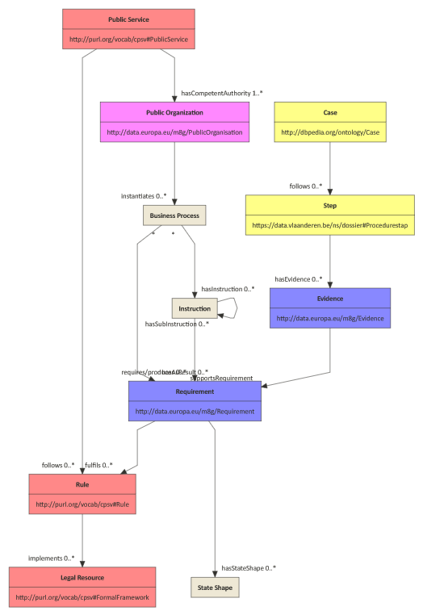
Model
Red
Vocabulary: CPSV v1.01
Application profile: CPSV-AP v3.1.0 / Dienstencataloog / Public Service
Implementation model: IPDC-LPDC
Pink
Vocabulary: CPOV v2.1.0 / Organisatie / Public Organization
Application profile: Organisatie Basis / Public Organization
Purple
Vocabulary: CCCEV 2.0
Yellow
Vocabulary: Dossier
Application profiel: Dossier
Notes:
#arrowSize: 1
#direction: down
#gutter: 5
#edgeMargin: 0
#gravity: 3
#edges: hard
#background: transparent
#fill: #eee8d5; #fdf6e3
#fillArrows: true
#font: Calibri
#fontSize: 12
#leading: 1.25
#lineWidth: 1
#padding: 15
#title: I'm moving V2
#zoom: 1
#acyclicer: greedy
#ranker: longest-path
#.cccev: fill=#8f8 title=center,normal,bold
#.cpsv: fill=#f88 title=center,normal,bold
#.steps: fill=#88f title=center,normal,bold
#.cpov: fill=#f8f title=center,normal,bold
#.dbp: fill=#ff8 title=center,normal,bold
[<cpsv>Public Service|
http://purl.org/vocab/cpsv#PublicService]
[Public Service]->hasCompetentAuthority 1..*[Public Organization]
// http://data.europa.eu/m8g/hasCompetentAuthority
[<cpov>Public Organization|
http://data.europa.eu/m8g/PublicOrganisation]
[Public Service]->follows 0..*[Rule]
//http://purl.org/vocab/cpsv#follows
[<cpsv>Rule|
http://purl.org/vocab/cpsv#Rule
]
[Rule]->implements 0..*[Legal Resource]
// http://purl.org/vocab/cpsv#implements
[<cpsv>Legal Resource|
http://data.europa.eu/eli/ontology#LegalResource]
[Public Organization]->instantiates 0..*[Business Process]
// NEW
[Business Process]
//[Business Process]*->adheresTo 0..*[Rule]
// NEW
[Business Process]*->hasAsResult 0..*[Requirement]
// NEW
// Meerdere procedures naar zelfde Regel? flavors!
[<steps>Requirement|
http://data.europa.eu/m8g/Requirement
// https://fast.ilabt.imec.be/ns/oslo-steps#State|
// Semantisch bescrijving
]
[Requirement]->fulfils 0..*[Rule]
// http://data.europa.eu/m8g/fulfils
[Business Process]*->hasInstruction 0..*[Instruction]
// NEW
// Procedure is in good flow een opeenvolging van stappen
// Is het nuttig om 1 good flow te hebben?
[Instruction
//https://fast.ilabt.imec.be/ns/oslo-steps#Step
// type: intern (overheid), extern (burger)
// (Data) voorwaarden semantisch
// Business rules? SBVR
// Assistentie?
// BeslissingsMoment?
]
[Instruction]->hasSubInstruction 0..*[Instruction]
// NEW
[Instruction]->requires/produces 0..*[Requirement]
// https://fast.ilabt.imec.be/ns/oslo-steps/index-en.html#requiresState
// https://fast.ilabt.imec.be/ns/oslo-steps/index-en.html#producesState
[Requirement]->hasStateShape 0..*[State Shape]
// https://fast.ilabt.imec.be/ns/oslo-steps#hasStateShape
[State Shape
//https://fast.ilabt.imec.be/ns/oslo-steps#StateShape
]
[<dbp>Case|
http://dbpedia.org/ontology/Case
//burger?
//status (procedure vs Dienstverlening?)
//status (stap)*
]
[Case]->follows 0..*[Step]
// https://data.vlaanderen.be/ns/dossier#doorloopt
[<dbp>Step |
https://data.vlaanderen.be/ns/dossier#Procedurestap
//BPEL?
]
[Step]->hasEvidence 0..*[Evidence]
[<steps>Evidence|
http://data.europa.eu/m8g/Evidence
]
[Evidence]->supportsRequirement[Requirement]
//http://data.europa.eu/m8g/supportsRequirement
//[Instruction]->[Organisatie]
//[<cpov>Organisatie|
//%http://www.w3.org/ns/org#Organization]
//[Dienstverlening]->produceert[Output]
//[Output|
//%http://data.europa.eu/m8g/Output|
//type: ConceptScheme ?
//description: string
//]
//[Business Process]sub->[Business Process]

Slide 12
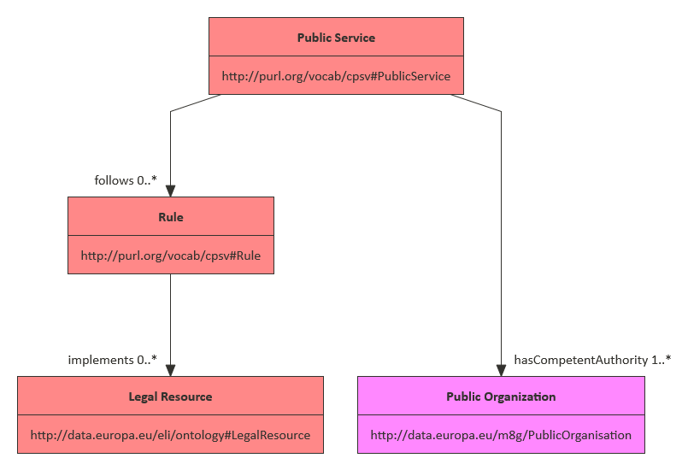
Model - Public Service
Notes:
#arrowSize: 1
#direction: down
#gutter: 5
#edgeMargin: 0
#gravity: 3
#edges: hard
#background: transparent
#fill: #eee8d5; #fdf6e3
#fillArrows: true
#font: Calibri
#fontSize: 12
#leading: 1.25
#lineWidth: 1
#padding: 15
#title: I'm moving V2
#zoom: 1
#acyclicer: greedy
#ranker: longest-path
#.cccev: fill=#8f8 title=center,normal,bold
#.cpsv: fill=#f88 title=center,normal,bold
#.steps: fill=#88f title=center,normal,bold
#.cpov: fill=#f8f title=center,normal,bold
#.dbp: fill=#ff8 title=center,normal,bold
[<cpsv>Public Service|
http://purl.org/vocab/cpsv#PublicService]
// http://data.europa.eu/m8g/hasCompetentAuthority
[<cpov>Public Organization|
http://data.europa.eu/m8g/PublicOrganisation]
[Public Service]->follows 0..*[Rule]
//http://purl.org/vocab/cpsv#follows
[Public Service]->hasCompetentAuthority 1..*[Public Organization]
[<cpsv>Rule|
http://purl.org/vocab/cpsv#Rule
]
[Rule]->implements 0..*[Legal Resource]
// http://purl.org/vocab/cpsv#implements
[<cpsv>Legal Resource|
http://data.europa.eu/eli/ontology#LegalResource]
//[Public Organization]->instantiates 0..*[Business Process]
// NEW
//[Business Process]
//[Business Process]*->adheresTo 0..*[Rule]
// NEW
//[Business Process]*->hasAsResult 0..*[Requirement]
// NEW
// Meerdere procedures naar zelfde Regel? flavors!
//[<steps>Requirement|
//http://data.europa.eu/m8g/Requirement
// https://fast.ilabt.imec.be/ns/oslo-steps#State|
// Semantisch bescrijving
//]
//[Requirement]->fulfils 0..*[Rule]
// http://data.europa.eu/m8g/fulfils
//[Business Process]*->hasInstruction 0..*[Instruction]
// NEW
// Procedure is in good flow een opeenvolging van stappen
// Is het nuttig om 1 good flow te hebben?
//[Instruction
//https://fast.ilabt.imec.be/ns/oslo-steps#Step
// type: intern (overheid), extern (burger)
// (Data) voorwaarden semantisch
// Business rules? SBVR
// Assistentie?
// BeslissingsMoment?
//]
//[Instruction]->hasSubInstruction 0..*[Instruction]
// NEW
//[Instruction]->requires/produces 0..*[Requirement]
// https://fast.ilabt.imec.be/ns/oslo-steps/index-en.html#requiresState
// https://fast.ilabt.imec.be/ns/oslo-steps/index-en.html#producesState
//[Requirement]->hasStateShape 0..*[State Shape]
// https://fast.ilabt.imec.be/ns/oslo-steps#hasStateShape
//[State Shape
//https://fast.ilabt.imec.be/ns/oslo-steps#StateShape
//]
//[<dbp>Case|
//http://dbpedia.org/ontology/Case
//burger?
//status (procedure vs Dienstverlening?)
//status (stap)*
//]
//[Case]->follows 0..*[Step]
// https://data.vlaanderen.be/ns/dossier#doorloopt
//[<dbp>Step |
//https://data.vlaanderen.be/ns/dossier#Procedurestap
//BPEL?
//]
//[Step]->hasEvidence 0..*[Evidence]
//[<steps>Evidence|
//http://data.europa.eu/m8g/Evidence
//]
//[Evidence]->supportsRequirement[Requirement]
//http://data.europa.eu/m8g/supportsRequirement
//[Instruction]->[Organisatie]
//[<cpov>Organisatie|
//%http://www.w3.org/ns/org#Organization]
//[Dienstverlening]->produceert[Output]
//[Output|
//%http://data.europa.eu/m8g/Output|
//type: ConceptScheme ?
//description: string
//]
//[Business Process]sub->[Business Process]

Slide 13
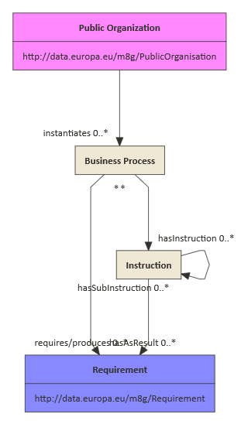
Model - Business Process

Slide 14
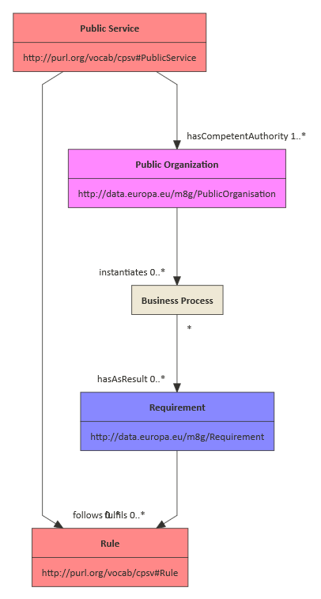
Model Business Process vs Public Service

Slide 15
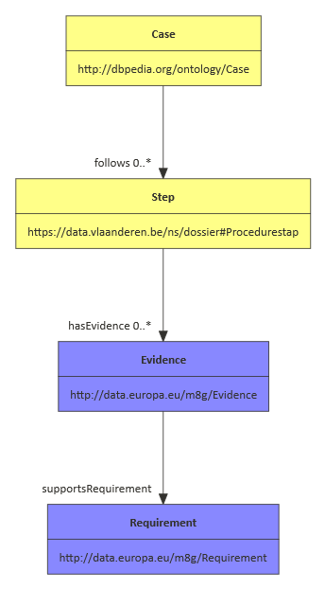
Model - Case
Notes:
#arrowSize: 1
#direction: down
#gutter: 5
#edgeMargin: 0
#gravity: 3
#edges: hard
#background: transparent
#fill: #eee8d5; #fdf6e3
#fillArrows: true
#font: Calibri
#fontSize: 12
#leading: 1.25
#lineWidth: 1
#padding: 15
#title: I'm moving V2
#zoom: 1
#acyclicer: greedy
#ranker: longest-path
#.cccev: fill=#8f8 title=center,normal,bold
#.cpsv: fill=#f88 title=center,normal,bold
#.steps: fill=#88f title=center,normal,bold
#.cpov: fill=#f8f title=center,normal,bold
#.dbp: fill=#ff8 title=center,normal,bold
//[<cpsv>Public Service|
//http://purl.org/vocab/cpsv#PublicService]
// http://data.europa.eu/m8g/hasCompetentAuthority
//[<cpov>Public Organization|
//http://data.europa.eu/m8g/PublicOrganisation]
//[Public Service]->follows 0..*[Rule]
//http://purl.org/vocab/cpsv#follows
//[Public Service]->hasCompetentAuthority 1..*[Public Organization]
//[<cpsv>Rule|
//http://purl.org/vocab/cpsv#Rule
//]
//[Rule]->implements 0..*[Legal Resource]
// http://purl.org/vocab/cpsv#implements
//[<cpsv>Legal Resource|
//http://data.europa.eu/eli/ontology#LegalResource]
//[Public Organization]->instantiates 0..*[Business Process]
// NEW
//[Business Process]
//[Business Process]*->adheresTo 0..*[Rule]
// NEW
//[Business Process]*->hasAsResult 0..*[Requirement]
// NEW
// Meerdere procedures naar zelfde Regel? flavors!
[<steps>Requirement|
http://data.europa.eu/m8g/Requirement
// https://fast.ilabt.imec.be/ns/oslo-steps#State|
// Semantisch bescrijving
]
//[Requirement]->fulfils 0..*[Rule]
// http://data.europa.eu/m8g/fulfils
//[Business Process]*->hasInstruction 0..*[Instruction]
// NEW
// Procedure is in good flow een opeenvolging van stappen
// Is het nuttig om 1 good flow te hebben?
//[Instruction
//https://fast.ilabt.imec.be/ns/oslo-steps#Step
// type: intern (overheid), extern (burger)
// (Data) voorwaarden semantisch
// Business rules? SBVR
// Assistentie?
// BeslissingsMoment?
//]
//[Instruction]->hasSubInstruction 0..*[Instruction]
// NEW
//[Instruction]->requires/produces 0..*[Requirement]
// https://fast.ilabt.imec.be/ns/oslo-steps/index-en.html#requiresState
// https://fast.ilabt.imec.be/ns/oslo-steps/index-en.html#producesState
//[Requirement]->hasStateShape 0..*[State Shape]
// https://fast.ilabt.imec.be/ns/oslo-steps#hasStateShape
//[State Shape
//https://fast.ilabt.imec.be/ns/oslo-steps#StateShape
//]
[<dbp>Case|
http://dbpedia.org/ontology/Case
//burger?
//status (procedure vs Dienstverlening?)
//status (stap)*
]
[Case]->follows 0..*[Step]
// https://data.vlaanderen.be/ns/dossier#doorloopt
[<dbp>Step |
https://data.vlaanderen.be/ns/dossier#Procedurestap
//BPEL?
]
[Step]->hasEvidence 0..*[Evidence]
[<steps>Evidence|
http://data.europa.eu/m8g/Evidence
]
[Evidence]->supportsRequirement[Requirement]
//http://data.europa.eu/m8g/supportsRequirement
//[Instruction]->[Organisatie]
//[<cpov>Organisatie|
//%http://www.w3.org/ns/org#Organization]
//[Dienstverlening]->produceert[Output]
//[Output|
//%http://data.europa.eu/m8g/Output|
//type: ConceptScheme ?
//description: string
//]
//[Business Process]sub->[Business Process]

Slide 16
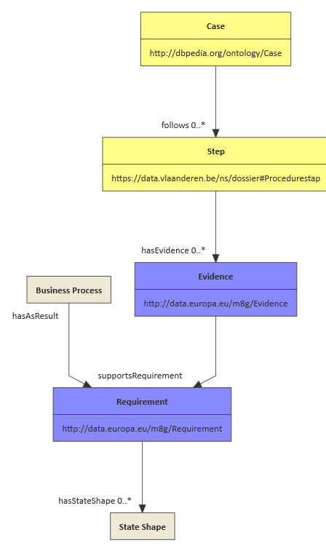
Model
Business Process vs Case
Notes:
#arrowSize: 1
#direction: down
#gutter: 5
#edgeMargin: 0
#gravity: 3
#edges: hard
#background: transparent
#fill: #eee8d5; #fdf6e3
#fillArrows: true
#font: Calibri
#fontSize: 12
#leading: 1.25
#lineWidth: 1
#padding: 15
#title: I'm moving V2
#zoom: 1
#acyclicer: greedy
#ranker: longest-path
#.cccev: fill=#8f8 title=center,normal,bold
#.cpsv: fill=#f88 title=center,normal,bold
#.steps: fill=#88f title=center,normal,bold
#.cpov: fill=#f8f title=center,normal,bold
#.dbp: fill=#ff8 title=center,normal,bold
//[<cpsv>Public Service|
//http://purl.org/vocab/cpsv#PublicService]
// http://data.europa.eu/m8g/hasCompetentAuthority
//[<cpov>Public Organization|
//http://data.europa.eu/m8g/PublicOrganisation]
//[Public Service]->follows 0..*[Rule]
//http://purl.org/vocab/cpsv#follows
//[Public Service]->hasCompetentAuthority 1..*[Public Organization]
//[<cpsv>Rule|
//http://purl.org/vocab/cpsv#Rule
//]
//[Rule]->implements 0..*[Legal Resource]
// http://purl.org/vocab/cpsv#implements
//[<cpsv>Legal Resource|
//http://data.europa.eu/eli/ontology#LegalResource]
//[Public Organization]->instantiates 0..*[Business Process]
// NEW
[Business Process]
//[Business Process]*->adheresTo 0..*[Rule]
// NEW
[Business Process] hasAsResult->[Requirement]
// NEW
// Meerdere procedures naar zelfde Regel? flavors!
[<steps>Requirement|
http://data.europa.eu/m8g/Requirement
// https://fast.ilabt.imec.be/ns/oslo-steps#State|
// Semantisch bescrijving
]
//[Requirement]->fulfils 0..*[Rule]
// http://data.europa.eu/m8g/fulfils
//[Business Process]*->hasInstruction 0..*[Instruction]
// NEW
// Procedure is in good flow een opeenvolging van stappen
// Is het nuttig om 1 good flow te hebben?
//[Instruction
//https://fast.ilabt.imec.be/ns/oslo-steps#Step
// type: intern (overheid), extern (burger)
// (Data) voorwaarden semantisch
// Business rules? SBVR
// Assistentie?
// BeslissingsMoment?
//]
//[Instruction]->hasSubInstruction 0..*[Instruction]
// NEW
//[Instruction]->requires/produces 0..*[Requirement]
// https://fast.ilabt.imec.be/ns/oslo-steps/index-en.html#requiresState
// https://fast.ilabt.imec.be/ns/oslo-steps/index-en.html#producesState
[Requirement]->hasStateShape 0..*[State Shape]
// https://fast.ilabt.imec.be/ns/oslo-steps#hasStateShape
//[State Shape
//https://fast.ilabt.imec.be/ns/oslo-steps#StateShape
//]
[<dbp>Case|
http://dbpedia.org/ontology/Case
//burger?
//status (procedure vs Dienstverlening?)
//status (stap)*
]
[Case]->follows 0..*[Step]
// https://data.vlaanderen.be/ns/dossier#doorloopt
[<dbp>Step |
https://data.vlaanderen.be/ns/dossier#Procedurestap
//BPEL?
]
[Step]->hasEvidence 0..*[Evidence]
[<steps>Evidence|
http://data.europa.eu/m8g/Evidence
]
[Evidence]->supportsRequirement[Requirement]
//http://data.europa.eu/m8g/supportsRequirement
//[Instruction]->[Organisatie]
//[<cpov>Organisatie|
//%http://www.w3.org/ns/org#Organization]
//[Dienstverlening]->produceert[Output]
//[Output|
//%http://data.europa.eu/m8g/Output|
//type: ConceptScheme ?
//description: string
//]
//[Business Process]sub->[Business Process]

Slide 17
Example

Slide 18
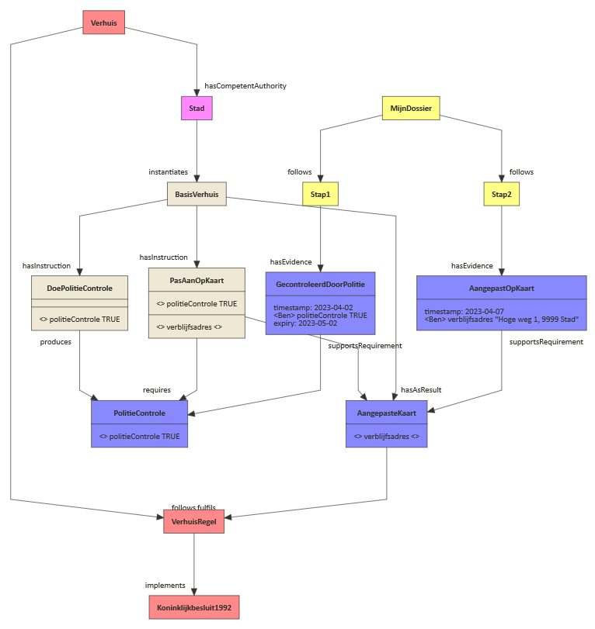
Notes:
#arrowSize: 1
#direction: down
#gutter: 5
#edgeMargin: 0
#gravity: 3
#edges: hard
#background: transparent
#fill: #eee8d5; #fdf6e3
#fillArrows: true
#font: Calibri
#fontSize: 12
#leading: 1.25
#lineWidth: 1
#padding: 15
#title: I'm moving full example
#zoom: 1
#acyclicer: greedy
#.cccev: fill=#8f8 title=center,normal,bold
#.cpsv: fill=#f88 title=center,normal,bold
#.steps: fill=#88f title=center,normal,bold
#.cpov: fill=#f8f title=center,normal,bold
#.dbp: fill=#ff8 title=center,normal,bold
[<cpsv>Verhuis]
[<cpov>Stad]
[Verhuis]->hasCompetentAuthority[Stad]
[<cpsv>VerhuisRegel]
[Verhuis]->follows[VerhuisRegel]
[<cpsv>Koninklijkbesluit1992]
[VerhuisRegel]->implements[Koninklijkbesluit1992]
[Stad]->instantiates[BasisVerhuis]
[<steps>AangepasteKaart|
<> verblijfsadres <>
]
[AangepasteKaart]->fulfils[VerhuisRegel]
[DoePolitieControle|
|
<> politieControle TRUE
]
[BasisVerhuis]->hasInstruction[DoePolitieControle]
[<steps>PolitieControle|
<> politieControle TRUE
]
[DoePolitieControle]produces->[PolitieControle]
[PasAanOpKaart|
<> politieControle TRUE|
<> verblijfsadres <>]
[BasisVerhuis]->hasInstruction[PasAanOpKaart]
[PasAanOpKaart]->requires[PolitieControle]
[PasAanOpKaart]produces->[AangepasteKaart]
[BasisVerhuis]->hasAsResult[AangepasteKaart]
[<dbp>MijnDossier]
[<dbp>Stap1]
[MijnDossier]->follows[Stap1]
[<dbp>Stap2]
[MijnDossier]->follows[Stap2]
[<steps>GecontroleerdDoorPolitie|
timestamp: 2023-04-02
<Ben> politieControle TRUE
expiry: 2023-05-02
]
[Stap1]->hasEvidence[GecontroleerdDoorPolitie]
[GecontroleerdDoorPolitie]supportsRequirement->[PolitieControle]
[<steps>AangepastOpKaart|
timestamp: 2023-04-07
<Ben> verblijfsadres "Hoge weg 1, 9999 Stad"
]
[Stap2]->hasEvidence[AangepastOpKaart]
[AangepastOpKaart]supportsRequirement->[AangepasteKaart]

Slide 19
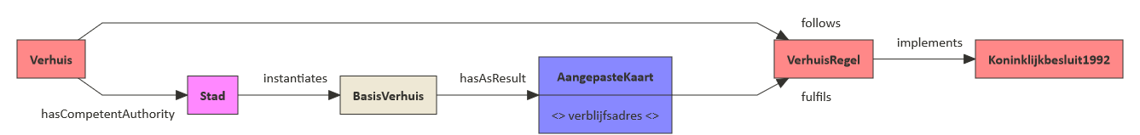
Service - Business Process
Notes:
#arrowSize: 1
#direction: right
#gutter: 5
#edgeMargin: 0
#gravity: 3
#edges: hard
#background: transparent
#fill: #eee8d5; #fdf6e3
#fillArrows: true
#font: Calibri
#fontSize: 12
#leading: 1.25
#lineWidth: 1
#padding: 15
#title: I'm moving full example_1
#zoom: 1
#acyclicer: greedy
#.cccev: fill=#8f8 title=center,normal,bold
#.cpsv: fill=#f88 title=center,normal,bold
#.steps: fill=#88f title=center,normal,bold
#.cpov: fill=#f8f title=center,normal,bold
#.dbp: fill=#ff8 title=center,normal,bold
[<cpsv>Verhuis]
[<cpov>Stad]
[Verhuis]->hasCompetentAuthority[Stad]
[<cpsv>VerhuisRegel]
[Verhuis]->follows[VerhuisRegel]
[<cpsv>Koninklijkbesluit1992]
[VerhuisRegel]->implements[Koninklijkbesluit1992]
[Stad]->instantiates[BasisVerhuis]
//[<steps>PolitieControle|
//<> politieControle TRUE
//]
[<steps>AangepasteKaart|
<> verblijfsadres <>
]
[BasisVerhuis]->hasAsResult[AangepasteKaart]
[AangepasteKaart]->fulfils[VerhuisRegel]
//[DoePolitieControle|
//|
//<> politieControle TRUE
//]
//[BasisVerhuis]->hasInstruction[DoePolitieControle]
//[DoePolitieControle]->produces[PolitieControle]
//[PasAanOpKaart|
//<> politieControle TRUE|
//<> verblijfsadres <>]
//[BasisVerhuis]->hasInstruction[PasAanOpKaart]
//[PasAanOpKaart]->requires[PolitieControle]
//[PasAanOpKaart]->produces[AangepasteKaart]
//[<dbp>MijnDossier]
//[<dbp>Stap1]
//[MijnDossier]->follows[Stap1]
//[<dbp>Stap2]
//[MijnDossier]->follows[Stap2]
//[<steps>GecontroleerdDoorPolitie|
//timestamp: 2023-04-02
//<Ben> politieControle TRUE
//expiry: 2023-05-02
//]
//[Stap1]->hasEvidence[GecontroleerdDoorPolitie]
//[GecontroleerdDoorPolitie]->supportsRequirement[PolitieControle]
//[<steps>AangepastOpKaart|
//timestamp: 2023-04-07
//<Ben> verblijfsadres "Hoge weg 1, 9999 Stad"
//]
//[Stap2]->hasEvidence[AangepastOpKaart]
//[AangepastOpKaart]->supportsRequirement[PasAanOpKaart]

Slide 20
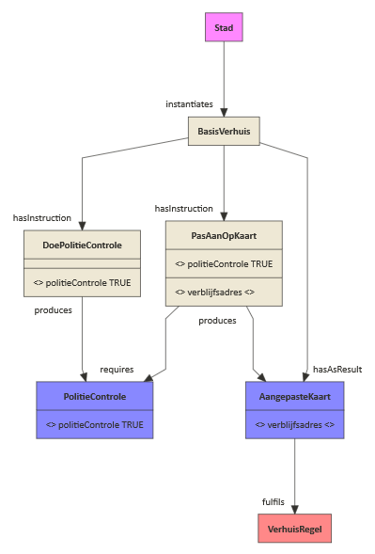
Business Process - Instructions
Notes:
#arrowSize: 1
#direction: down
#gutter: 5
#edgeMargin: 0
#gravity: 3
#edges: hard
#background: transparent
#fill: #eee8d5; #fdf6e3
#fillArrows: true
#font: Calibri
#fontSize: 12
#leading: 1.25
#lineWidth: 1
#padding: 15
#title: I'm moving full example_2
#zoom: 1
#acyclicer: greedy
#.cccev: fill=#8f8 title=center,normal,bold
#.cpsv: fill=#f88 title=center,normal,bold
#.steps: fill=#88f title=center,normal,bold
#.cpov: fill=#f8f title=center,normal,bold
#.dbp: fill=#ff8 title=center,normal,bold
//[<cpsv>Verhuis]
[<cpov>Stad]
//[Verhuis]->hasCompetentAuthority[Stad]
[<cpsv>VerhuisRegel]
//[Verhuis]->follows[VerhuisRegel]
//[<cpsv>Koninklijkbesluit1992]
//[VerhuisRegel]->implements[Koninklijkbesluit1992]
[Stad]->instantiates[BasisVerhuis]
[<steps>AangepasteKaart|
<> verblijfsadres <>
]
[AangepasteKaart]->fulfils[VerhuisRegel]
[DoePolitieControle|
|
<> politieControle TRUE
]
[BasisVerhuis]->hasInstruction[DoePolitieControle]
[<steps>PolitieControle|
<> politieControle TRUE
]
[DoePolitieControle]produces->[PolitieControle]
[PasAanOpKaart|
<> politieControle TRUE|
<> verblijfsadres <>]
[BasisVerhuis]->hasInstruction[PasAanOpKaart]
[PasAanOpKaart]->requires[PolitieControle]
[PasAanOpKaart]produces->[AangepasteKaart]
[BasisVerhuis]->hasAsResult[AangepasteKaart]
//[<dbp>MijnDossier]
//[<dbp>Stap1]
//[MijnDossier]->follows[Stap1]
//[<dbp>Stap2]
//[MijnDossier]->follows[Stap2]
//[<steps>GecontroleerdDoorPolitie|
//timestamp: 2023-04-02
//<Ben> politieControle TRUE
//expiry: 2023-05-02
//]
//[Stap1]->hasEvidence[GecontroleerdDoorPolitie]
//[GecontroleerdDoorPolitie]->supportsRequirement[PolitieControle]
//[<steps>AangepastOpKaart|
//timestamp: 2023-04-07
//<Ben> verblijfsadres "Hoge weg 1, 9999 Stad"
//]
//[Stap2]->hasEvidence[AangepastOpKaart]
//[AangepastOpKaart]->supportsRequirement[PasAanOpKaart]

Slide 21
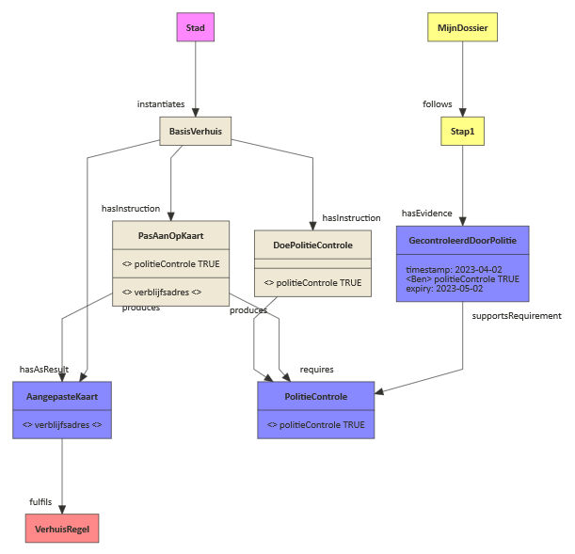
Case step 1
Notes:
#arrowSize: 1
#direction: down
#gutter: 5
#edgeMargin: 0
#gravity: 3
#edges: hard
#background: transparent
#fill: #eee8d5; #fdf6e3
#fillArrows: true
#font: Calibri
#fontSize: 12
#leading: 1.25
#lineWidth: 1
#padding: 15
#title: I'm moving full example_3
#zoom: 1
#acyclicer: greedy
#.cccev: fill=#8f8 title=center,normal,bold
#.cpsv: fill=#f88 title=center,normal,bold
#.steps: fill=#88f title=center,normal,bold
#.cpov: fill=#f8f title=center,normal,bold
#.dbp: fill=#ff8 title=center,normal,bold
//[<cpsv>Verhuis]
[<cpov>Stad]
//[Verhuis]->hasCompetentAuthority[Stad]
[<cpsv>VerhuisRegel]
//[Verhuis]->follows[VerhuisRegel]
//[<cpsv>Koninklijkbesluit1992]
//[VerhuisRegel]->implements[Koninklijkbesluit1992]
[Stad]->instantiates[BasisVerhuis]
[<steps>AangepasteKaart|
<> verblijfsadres <>
]
[AangepasteKaart]->fulfils[VerhuisRegel]
[DoePolitieControle|
|
<> politieControle TRUE
]
[BasisVerhuis]->hasInstruction[DoePolitieControle]
[<steps>PolitieControle|
<> politieControle TRUE
]
[DoePolitieControle]produces->[PolitieControle]
[PasAanOpKaart|
<> politieControle TRUE|
<> verblijfsadres <>]
[BasisVerhuis]->hasInstruction[PasAanOpKaart]
[PasAanOpKaart]->requires[PolitieControle]
[PasAanOpKaart]produces->[AangepasteKaart]
[BasisVerhuis]->hasAsResult[AangepasteKaart]
[<dbp>MijnDossier]
[<dbp>Stap1]
[MijnDossier]->follows[Stap1]
//[<dbp>Stap2]
//[MijnDossier]->follows[Stap2]
[<steps>GecontroleerdDoorPolitie|
timestamp: 2023-04-02
<Ben> politieControle TRUE
expiry: 2023-05-02
]
[Stap1]->hasEvidence[GecontroleerdDoorPolitie]
[GecontroleerdDoorPolitie]supportsRequirement->[PolitieControle]
//[<steps>AangepastOpKaart|
//timestamp: 2023-04-07
//<Ben> verblijfsadres "Hoge weg 1, 9999 Stad"
//]
//[Stap2]->hasEvidence[AangepastOpKaart]
//[AangepastOpKaart]supportsRequirement->[PasAanOpKaart]

Slide 22
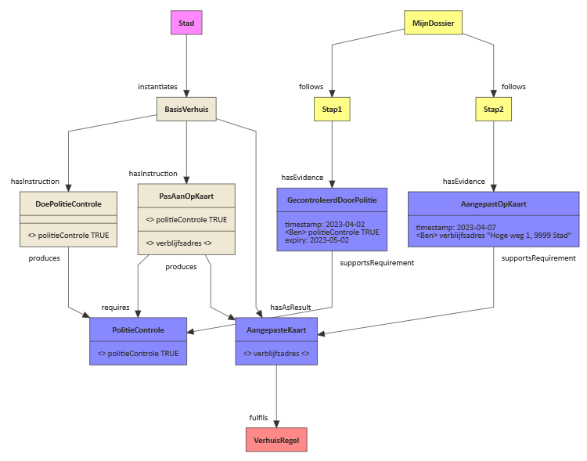
Case step 2
Notes:
#arrowSize: 1
#direction: down
#gutter: 5
#edgeMargin: 0
#gravity: 3
#edges: hard
#background: transparent
#fill: #eee8d5; #fdf6e3
#fillArrows: true
#font: Calibri
#fontSize: 12
#leading: 1.25
#lineWidth: 1
#padding: 15
#title: I'm moving full example_4
#zoom: 1
#acyclicer: greedy
#.cccev: fill=#8f8 title=center,normal,bold
#.cpsv: fill=#f88 title=center,normal,bold
#.steps: fill=#88f title=center,normal,bold
#.cpov: fill=#f8f title=center,normal,bold
#.dbp: fill=#ff8 title=center,normal,bold
//[<cpsv>Verhuis]
[<cpov>Stad]
//[Verhuis]->hasCompetentAuthority[Stad]
[<cpsv>VerhuisRegel]
//[Verhuis]->follows[VerhuisRegel]
//[<cpsv>Koninklijkbesluit1992]
//[VerhuisRegel]->implements[Koninklijkbesluit1992]
[Stad]->instantiates[BasisVerhuis]
[<steps>AangepasteKaart|
<> verblijfsadres <>
]
[AangepasteKaart]->fulfils[VerhuisRegel]
[DoePolitieControle|
|
<> politieControle TRUE
]
[BasisVerhuis]->hasInstruction[DoePolitieControle]
[<steps>PolitieControle|
<> politieControle TRUE
]
[DoePolitieControle]produces->[PolitieControle]
[PasAanOpKaart|
<> politieControle TRUE|
<> verblijfsadres <>]
[BasisVerhuis]->hasInstruction[PasAanOpKaart]
[PasAanOpKaart]->requires[PolitieControle]
[PasAanOpKaart]produces->[AangepasteKaart]
[BasisVerhuis]->hasAsResult[AangepasteKaart]
[<dbp>MijnDossier]
[<dbp>Stap1]
[MijnDossier]->follows[Stap1]
[<dbp>Stap2]
[MijnDossier]->follows[Stap2]
[<steps>GecontroleerdDoorPolitie|
timestamp: 2023-04-02
<Ben> politieControle TRUE
expiry: 2023-05-02
]
[Stap1]->hasEvidence[GecontroleerdDoorPolitie]
[GecontroleerdDoorPolitie]supportsRequirement->[PolitieControle]
[<steps>AangepastOpKaart|
timestamp: 2023-04-07
<Ben> verblijfsadres "Hoge weg 1, 9999 Stad"
]
[Stap2]->hasEvidence[AangepastOpKaart]
[AangepastOpKaart]supportsRequirement->[AangepasteKaart]

Slide 23
Alignment with OSLO-STEPS
Since the inception of OSLO-STEPS, CCCEV 2.0 was released. We can see following mappings
oslo-steps:Step → ex:Instruction: A choice was made to rename this concept to clarify the difference between an instruction (i.e., describing what to do) and a step (i.e., describing what you have done). The concepts oslo-steps:JourneyLevelStep, oslo-steps:ContainerLevelStep, and oslo-steps:ComponentLevelStep remain to clarify the hierarchy between ex:Instructions.
oslo-steps:State → cccev:Requirement: CCCEV’s Requirement covers the same definition as OSLO-STEPS’ State.
oslo-steps:StateShape → sh:NodeShape: SHACL’s NodeShape covers the same definition as OSLO-STEPS’ StateShape.

Slide 24
Conclusions
The proposed model nicely aligns with existing mature vocabularies, and only introduces complementary terms. The concept of a Business Process was missing in existing standards and OSLO-Steps, and is hereby introduced. Next to that, combining OSLO-steps concepts and CCCEV concepts allowed us to glue these existing vocabularies together.
Two things are not strictly specified within this proposal:
The order between steps is only implicitly defined when looking at how the requirements depend on each other
The semantic description of business rules is out of scope

Slide 25
Future work - Business Rules
Predefining a fixed set of available operators to build business rules upon. Although the most simple choice, one must be aware that this fixed set will constantly evolve to cope with changing requirements.
Defining an extension mechanism to define business rules as externally defined functions that can be maintained and developed in parallel. The Function Ontology is a potential solution to allow declarative business rules without limiting the scope, complexity, or implementation.
A hybrid solution.

Slide 26
Future work - smaller recommendations
Evaluating the current CPSV application profiles (Dienstencataloog and Public Service) in light of the latest CPSV v3 release, to see whether these can be reconciled and updated.
Extend the Public Service class to a more general Service. At the moment: it is not possible to describe services that are not performed by or on behalf of a public agency.

Slide 27
ICEG Hydrants

Slide 28
State-of-play
The second meeting took place on April 18th with good feedback received.
The team presented a first data model that is currently being reworked.
Questions and parts to review have been derived out of the model for participants to review offline.
Weekly communication is foreseen until the next webinar.
There is a lack of participation from French-speaking organisations, and we will remediate by seeking input offline.
The next meeting is scheduled for Tuesday, May 23rd, during which we'll present a refined version of the model (EAP) before kicking off the review period for June, July, and August.

Slide 29
ICEG Building

Slide 30
State-of-play
Budget discussion is ongoing.
Participants identified and invited to an extra iteration planned for May 31st.
The meeting has been requested to be held in both Dutch and French languages.
Few reminders are foreseen before the meeting to ensure participants review the model.

Slide 31
OSLO standard adoption process

Slide 32
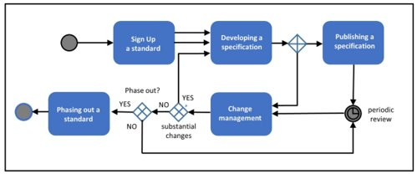
Growing need for a shortened procedure
Actual procedure for elaborating a data standard ​
Growing number of requests: adoption of OSLO standard to ICEG standard (eg Mobility, KLIP, Person,…)​
Proposed suggestion during previous ICEG review Comité:​
Translation of all OSLO standards as inspirational documents (potential ICEG standards)​ and publication on ICEG environment
Relevant standards can be refined in (a) thematic working group(s)​
Standards that cannot be endorsed in step (b) because they require adjustments at A full ICEG change management track when endorsement is not possible in (2)​
ICEG Review Comite chooses and approves the approach needed

Slide 33
Shortened procedure – STEP 1: translation
GOAL: ​
inspiration and insights on OSLO standards for the ICEG community​
APPROACH:​
Semi – automatic translation of all (+130) OSLO standards into English​
Translations will be published on ICEG GitHuB​
No working group will be organized in this phase​
Translator tool is Bing-based, so documents are inspirational only​
COSTS:​
Translation of all OSLO standards: 130k€

Slide 34
Shortened procedure – STEP 2: scenario a
SCENARIO: Refinement of the translated standard with (a) working group(s)
GOAL: ​
Shortened procedure to adopt an OSLO standard
APPROACH:​
Quality Assessment of the translation and insights in the standard​
Organisation of a first working group, including preparation and report​
Short public review for issues (1 month), processing issues and accreditation standard​
(optional) Additional working group when standard cannot be endorsed in one working group, including preparation and report
COSTS:​
Quality assessment: 5k€​
First working group, public review and processing issues: 8,1 k€​
(optional) Additional working group: 8,1 k€

Slide 35

Shortened procedure – STEP 2: scenario b
SCENARIO: Semantic changes with impact – several working groups
GOAL: ​
ICEG standardization of a standard, due to semantic changes as defined in the ICEG Process & Methodology
APPROACH:​
When semantic changes are needed that have an impact on the (translated) standard overall:
COSTS:​
Standardisation trajectory: 71,1 k€

Slide 36
OTHER / VARIA

Slide 37
OTHER
ICEG Time Table & Planning - public review ends mid May - issues on github need to be looked at - next steps ?
Persons (KSZ/BCSS exercise) - Geert Thijs and Liesbet D'Hondt want to have access to the ICEG toolchain - who can help ?

